Slide 1
NOIRLab Data Services: a Practical Demo of Science with the Dark Energy Survey
Knut Olsen, Robert Nikutta, Chien-Hsiu Lee, and Bryan Miller
NSF’s NOIRLab

Slide 2
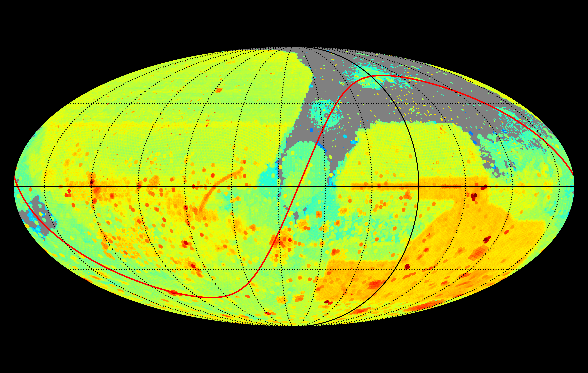
Survey data at NOIRLab
Imaging dataset volume growing quickly
Billions of astronomical objects
ZTF alert stream brokering
Opportunities to schedule rapid follow-up with NOIRLab facilities (e.g. Gemini, SOAR)

Slide 3
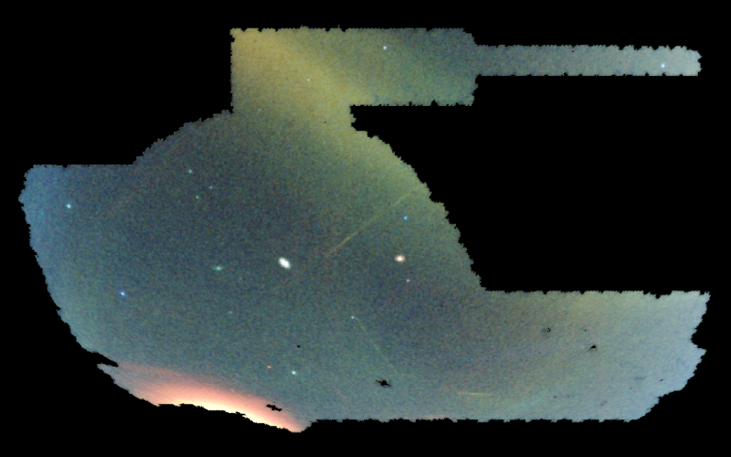
Searching for Milky Way structure
Low surface brightness Milky Way halo dwarf galaxies and streams provide are a window into our Galaxy’s accretion history
Opportunity to probe dark matter
Key pieces in galaxy formation puzzle
DECam imaging and Dark Energy Survey are treasure troves of discovery potential
NOIRLab data services can help you take full advantage!
Shipp et al. (2018)

Slide 4
NOIRLab data services enable survey science
Astro Data Archive: efficient search of petascale data volume
Astro Data Lab: flexible online science platform for analysis of billions of catalog objects from multiple datasets
ANTARES: customizable time domain alert stream broker to pick out the most exciting events in massive alert streams (ZTF, future Rubin LSST)
TOM Toolkit/AEON: rapidly schedule follow-up observations with NOIRLab facilities

Slide 5
Enabling discovery in DES
DES depth map with Archive (Demo: Knut Olsen)
Discovery of MW dwarfs and streams in DES catalog data with Data Lab (Demo: Robert Nikutta)
Discovery of variable stars in dwarf in ZTF alert stream with ANTARES (Demo: Chien-Hsiu Lee)
Trigger of Gemini observation with AEON (Demo: Bryan Miller)

Slide 6
Conclusion
Visit us at the NOIRLab booth to ask how to make NOIRLab services work for you!

